Slide 1
Data Base System Week 4th Topics
Model
Data Model
Types of Model
Relational Data Model Concepts and Terminologies
DBMS vs RDBMS

Slide 2
Data Base System Week 4th Topics
Model
is the abstract representation of objects, events and their association
Data Model
is the abstract representation of data about entities, events, activities and their association in an organization
Purpose
To represent data in an understandable way
Parts of Data Model
Structural Part: consists set of rules i.e. how a database can be developed i.e. terminologies
Manipulative Part: defines the type of operations that can be performed on data
Set of Integrity Rules: ensures the accuracy of data in DB also called constraints

Slide 3
Data Base System Week 4th Topics
Categories of Data Models
Object-based
Record-based
Physical.
2. Record-based Data Model
Used to describe external and conceptual level of database and can describe internal level to some extent
Database consists of different records may be of different types
Each record define a fixed number of fields
Types
Relational Data Model
Network Data Model
Hierarchical Data Model

Slide 4
Data Base System Week 4th Topics
Relational Data Model
Dr. E.F Codd and his associate at IBM research laboratory proposed in 1970 by applying the rules of mathematics
Presented a paper “A relational Model of Data for Large Shared Databanks” contained 12 rules
A DBMS that satisfy these rules is called RDBMS
INGRES (Interactive Graphics and Relational System) was an early relational model
So relational data model represent data in DB as a collection of relations
Relational Database is a collection of normalized relations with distinct relation names.
Structural Part: (Terminology)
Relation
A relation is a table with columns and rows.
Only applies to logical structure of the database, not the physical structure
it represent entities and their relationships
every relation will be visualized by name
Every relation is a table but every table is not a relation
Flat Table: A flat DB(File) consists of only one table

Slide 5
Data Base System Week 4th Topics
Relational Data Model
Attribute
Attribute is a named column of a relation with unique name
Degree
Degree is the number of attributes in a relation
Tuple
Tuple is a row of a relation
Cardinality
Cardinality is the number of tuples in a relation
Domain
Domain is the set of allowable values for one or more attributes

Slide 6
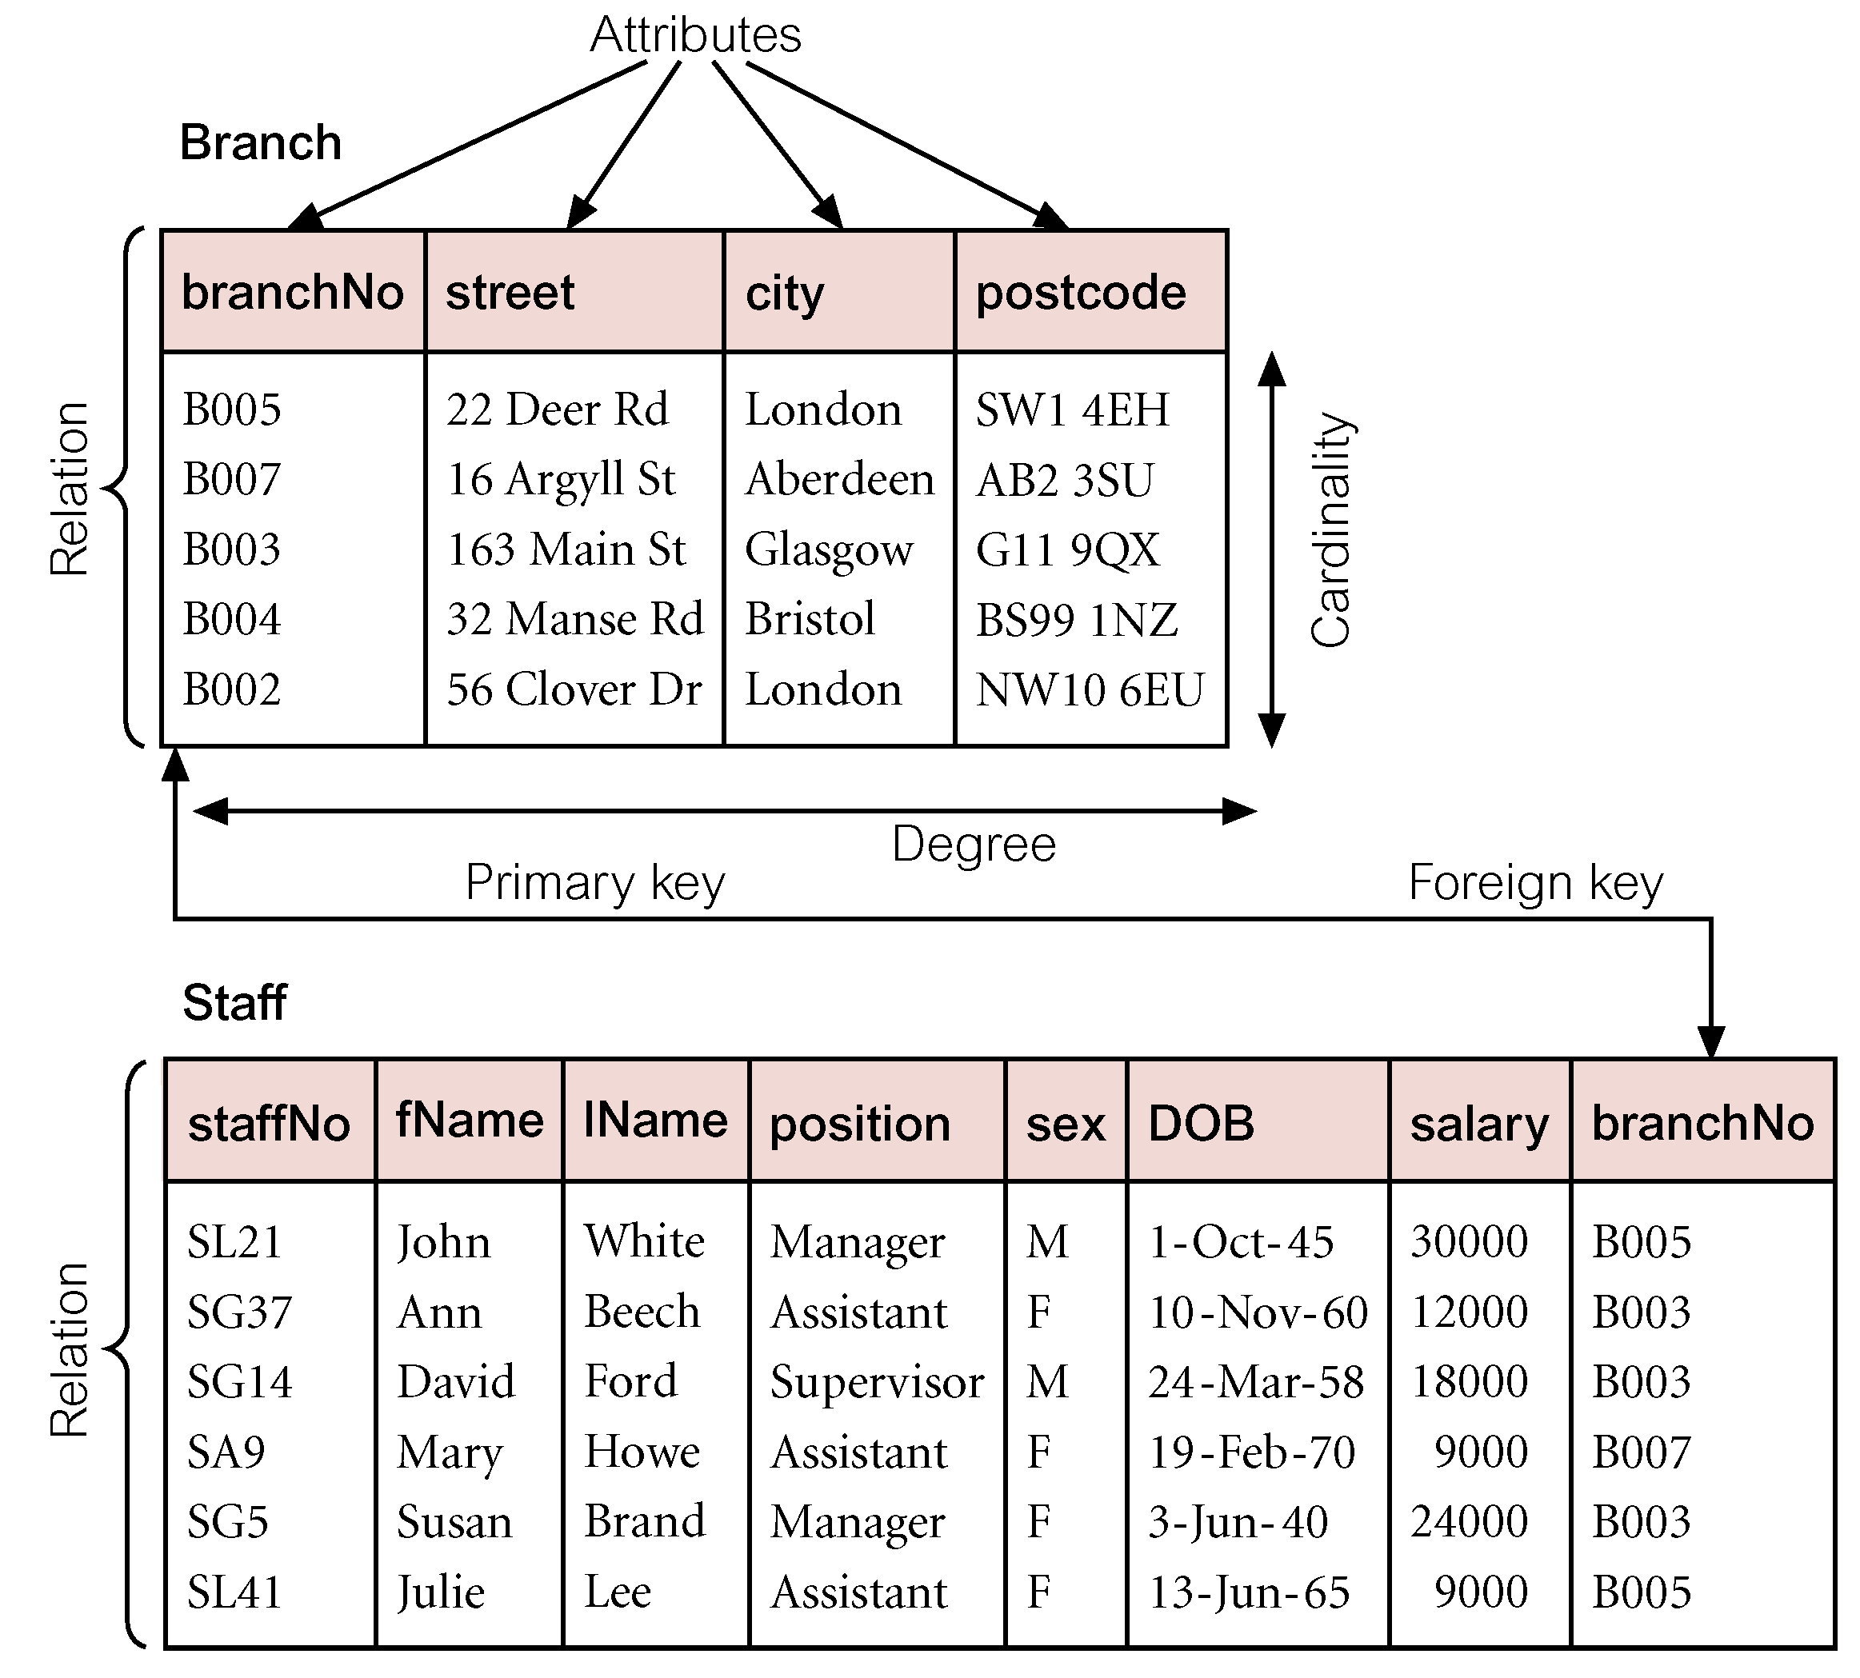
Data Base System Week 4th Topics
Relational Data Model

Slide 7
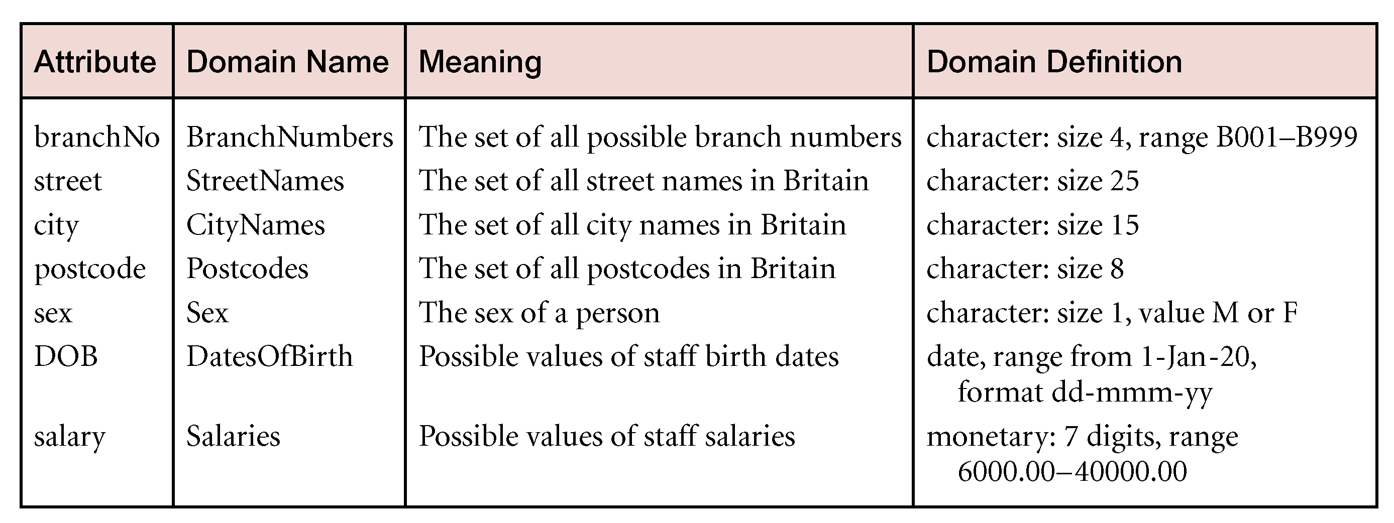
Data Base System Week 4th Topics
Domain Example

Slide 8
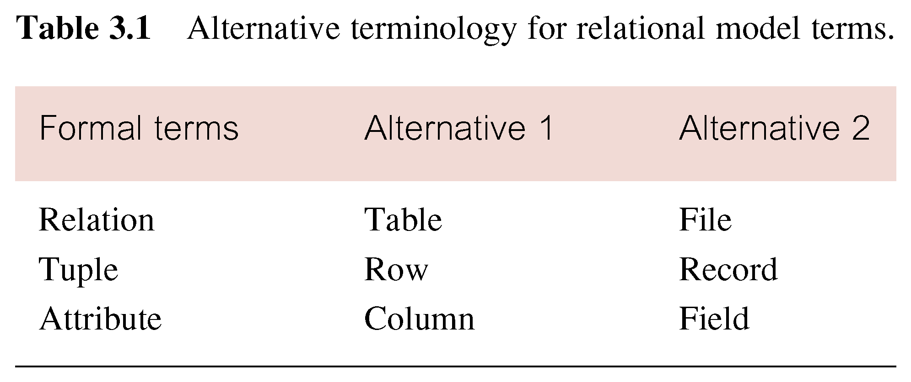
Data Base System Week 4th Topics

Slide 9
Data Base System Week 4th Topics
Properties of Relations
Relation name is distinct from all other relation names in relational schema.
Each cell of relation contains exactly one atomic (single) value.
Each attribute has a distinct name.
Values of an attribute are all from the same domain.
Each tuple is distinct; there are no duplicate tuples.
Order of attributes has no significance.
Order of tuples has no significance, theoretically.
Key
Uniquely identify a record
Representation of Relation
Pictorial
Schema (Extension)
DD/D (Intension)
Entity Diagram

Slide 10
Data Base System Week 4th Topics
Base Relation
Named relation corresponding to an entity in conceptual schema, whose tuples are physically stored in database.
View
Dynamic result of one or more relational operations operating on base relations to produce another relation.
A virtual relation that does not necessarily actually exist in the database but is produced upon request, at time of request.
Contents of a view are defined as a query on one or more base relations.
Views are dynamic, meaning that changes made to base relations that affect view attributes are immediately reflected in the view.

Slide 11
Data Base System Week 4th Topics
DBMS | RDBMS
DBMS data is stored in the form of rows and columns | RDMS data stored in the form of Relations
Data stored in DBMS is temporarily | where as in rdbms is permanently
In DBMS keys are not used | In RDBMS keys are used
In DBMS duplication of rows and columns | But in RDBMS there is no duplication of rows and columns
DBMS is for single user only | RDBMS is for multi-user
DBMS does not satisfies codd's rules. | RDBMS satisfies codd's rules
Eg: DBMS: Sysbase foxpro | Eg: RDBMS: Oracle, SQl server

Slide 12
Data Base System Week 4th Topics
Uses of RDBMS in different sectors: Database is widely used all around the world in different sectors: 1.Banking: For customer information, accounts loans and banking transactions. 2.Airlines: For reservations and schedule information. Airlines were among the first to use database in a geographically disturbed manner-terminals situated around the world accessed the central database system through phone lines and other data networks. 3.Universities: For student information, course registrations and grades. 4.Credit card transactions: For purchases on credit cards and generation of monthly statements. 5.Telecommunications: For keeping records of calls made, generating monthly bills, maintaining balances on prepaid calling cards and storing information about the communication networks.
6.Finance: For storing information about holdings, sales and purchase of financial instruments such as stocks and bonds. 7.Sales: For customer, product and purchase information.
8.Manufacturing: For management of supply chain and for tracking production of items in factories, inventories of items in warehouses/stores and orders for items.
9.Human Resources: For information about employees, salaries, payroll taxes and benefits and for generation of paychecks. 10.Web based services: For taking web users feedback, responses, resource sharing etc.

